Slide 1


Mortgage Approval Time Analysis
Global Operations
Sneha Arora

Slide 2
Introduction
AIM
To reduce Mortgage approval time
For Improving Customer Experience
01
02
03
Time spent by Pre-Fund Team
First Time Right
Branch Time
Analysing the time spent by the Branch to submit/resubmit application to review team.
Analysing the time spent by Pre-Fund team to review notifications
Number of First Submits.
Number of Re-submits per application

Slide 3
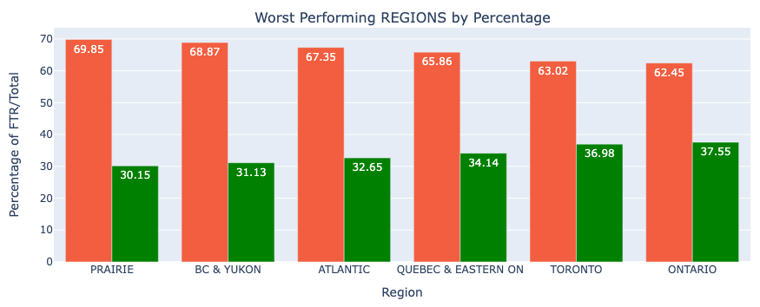

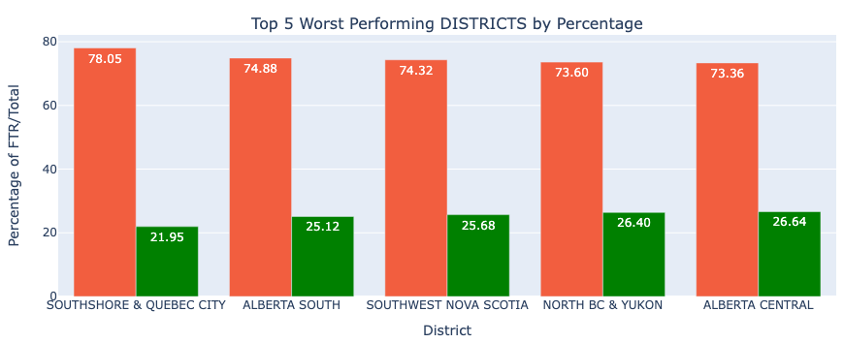
Showcase which Regions and Districts were the worst performing when it comes to first time right.
Worst Performing Region
PRAIRIE at 69%
BC & YUKON at 68%
PRAIRIE Worst
Ontario Best
Worst Performing District
SOUTHSHORE & QUEBEC CITY at 78%
ALBERTA SOUTH at 74%

Slide 4
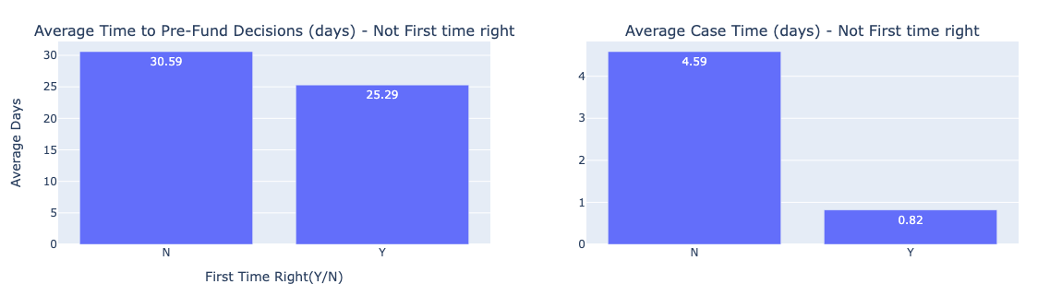


What is the impact on ‘Time to Pre-Fund Decision’ and ‘Case Time’ when a case is not first time right?
Measuring impact by Average
4.5x
20% more average time taken for Pre-Fund decisions, for first time not right cases, than first time right cases.
459% more average Case Time, for not first time right cases, than first time right cases.

Slide 5
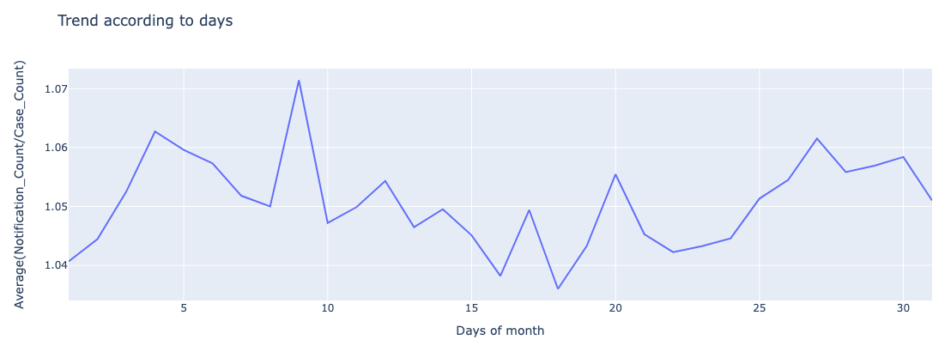
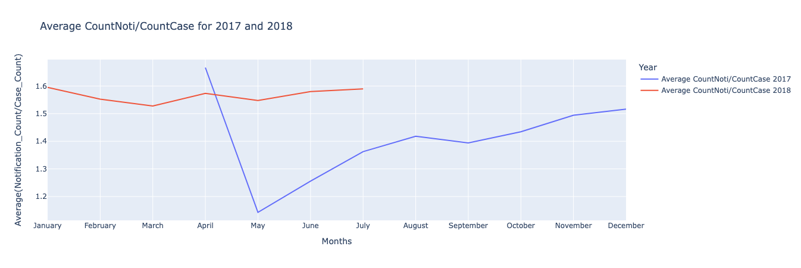
What is the average number of notifications associated with each case and are there any trends positive or negative?
Days of month (1-31)
Higher towards start and end of the month, lower in middle. Not much difference overall (~3% range)
Average # Notification/Case is in the range of 1.6 and 1.2
Monthly
Rising trend from the month of May for both Years 2017 and 2018.
Year - 2018 shows more average than Year - 2017.

Slide 6
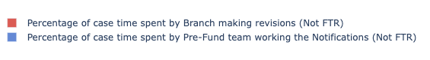
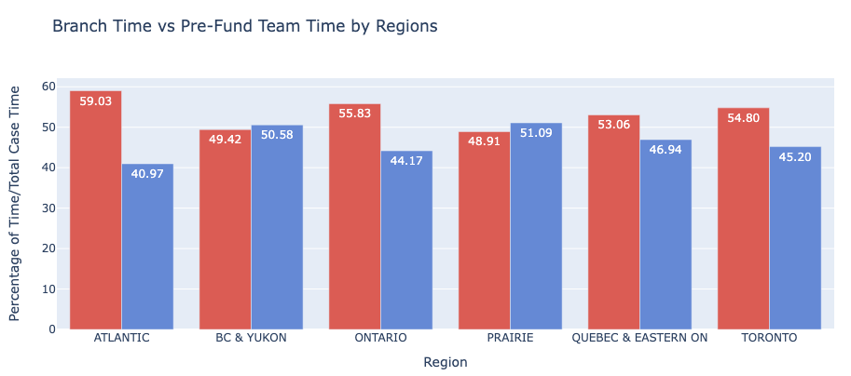
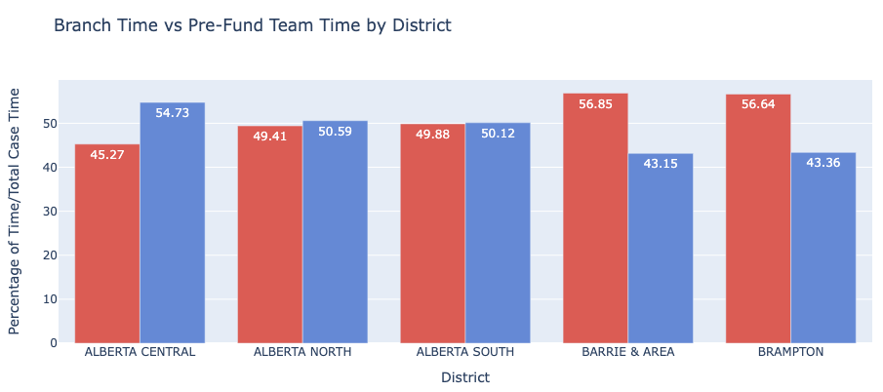
When a case is not first time right, what is the percent of total case time spent with the branch making revisions vs. Pre-Fund working the notifications.
ATLANTIC region spends about 59% of time for Branch making revisions followed by ONTARIO which takes 55.8% time.
Both the Branch Revisions team and the Pre-Fund team are almost equally responsible for the delay in applications.
Time spent by Pre-Fund team working the notifications is maximum shown by the PRAIRIE region by 51% followed by BC & YUKON i.e. 50.57%.

Slide 7
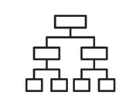
Build a predictive model using Jupyter* and Scikit-learn* to predict FTR – First Time Right. Explain how to use the model to drive improved Operations or Business Process
The model considered is Decision Tree which gives ~70 % accurate results.
The following features are considered to predict First Time Right in the given priority order:
Insights
Since age of property shows as first important feature to FTR, a separate queue/team can handle older property cases to reduce overall delays.
Features Used to build the model :
Age of Property
Application Method
Job Category
Tenure (Years)
Region
Application Month
Age of the property
Application method (applied through branch/app)
Separate departments can handle the applications coming from Branch and App (web-app) to improve the operations.
Job Category of the applicant
Training of existing staff, sharing of best practices from Top performing Regions and additional staff can be considered to improve FTR cases in poor performing Regions and Districts.
and so on ...
Notes:
The first important factor is Age of property that is used to predict the FTR. We can separate the application files to different review teams based on higher age of property or lower. This could improve the processes and make the process faster.
Application method acts as a second important factor i.e. separating the files coming from Branch and App (web app) will be useful in optimized operations.
To accommodate review of applications by different departments and teams either we can train the existing staff or hire more staff. We can also change the time-shifts of the existing staff in an optimised manner.

Slide 8
Thank You

